Slide 1
Presentation 4
Concepts and Equations of
Variable-Density Groundwater Flow
Notes:
SEAWAT Training Course
Lecture 4

Slide 2
Fluid Density (ρ)
Total Mass (fluid and salt) / Volume
Dimensions [ML⁻³]
Commonly denoted with ρ
Typical Values for Water
  Fresh: ρ = 1000 kg/m³; ρ = 62.43 lbs/ft³
  Seawater: ρ = 1025 kg/m³; ρ = 64.00 lbs/ft³

Slide 3
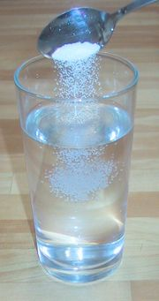
Solute Concentration (C)
Solute mass fraction (ω)
  Mass of solute / total mass of fluid
Solute volumetric concentration (C)
  Mass of solute / volume of fluid
Relation: C = ρ * ω

Slide 4

Solutal Expansion
35 kg
0.0098 m
=
saltwater
1 m
ρ = 1035 kg/m³
ρ = 1025 kg/m³
freshwater
1 m
1 m
ρ = 1000 kg/m³
1 m
1 m
1 m

Slide 5
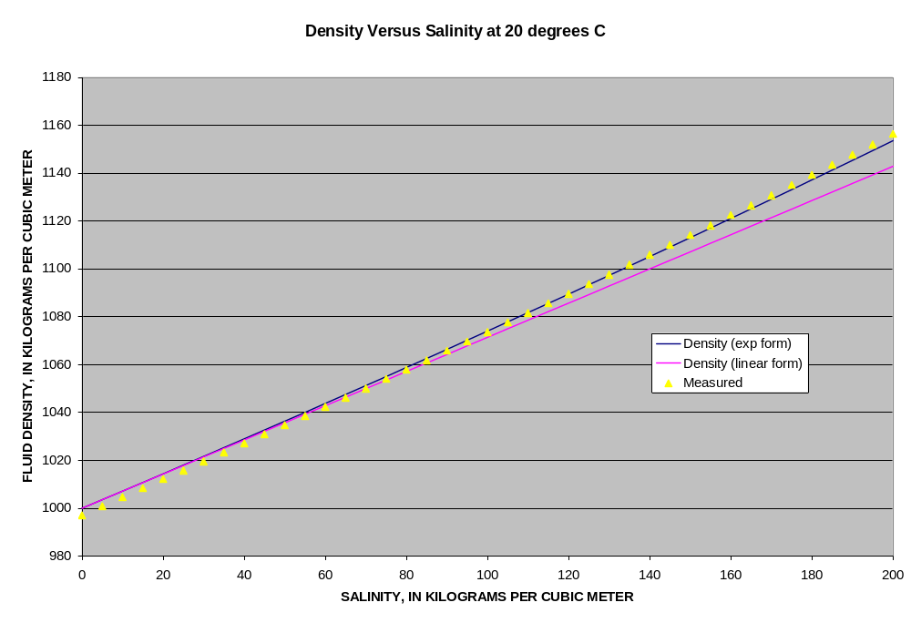
Source for measured values: http://www.unisense.com/support/pdf/gas_tables.pdf

Slide 6
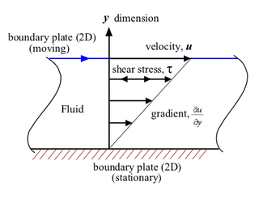
Dynamic Viscosity (μ)
Defined as the internal resistance of fluid to deform under shear stress
Dimensions [ML⁻¹T⁻¹]
Values:
  Water, μ = 8.9 x 10⁻⁴ kg m⁻¹ s⁻¹
  Olive oil, μ = 8.1 x 10⁻² kg m⁻¹ s⁻¹
Dynamic viscosity is related to kinematic viscosity (ν) with the following equation:
  ν = μ / ρ

Slide 7
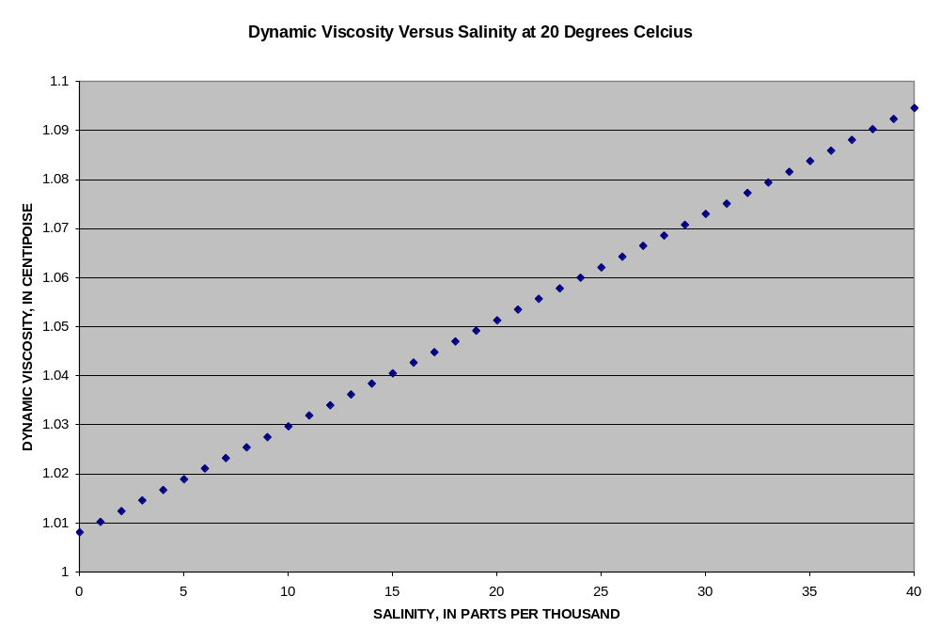
Source: http://www.unisense.com/support/pdf/gas_tables.pdf

Slide 8
Pressure (P)
Definition: Force per unit area
Dimensions: [ML⁻¹T⁻²]
Typical units: N/m²
For a column of water of height, h, the hydrostatic pressure is:
  P = ρ g h
Absolute versus gauge pressure

Slide 9
Hydrostatic Conditions
Pressure increases with depth according to the weight of the fluid
dP/dz = ρg

Slide 10
Buoyancy
Upward force (F_{b}) on a submersed object equal to the weight of the displaced fluid
  F_{b} = ρ_{fluid} V_{object} g
Movement occurs due to differences between F_{b} and F_{g} (F_{g} = m_{object} g)
neutral
F_{b} = F_{g}
freshwater floats in seawater
F_{b} > F_{g}
brine sinks in seawater
F_{b} < F_{g}
F_{b}
F_{b}
F_{b}
F_{g}
F_{g}
F_{g}
seawater

Slide 11
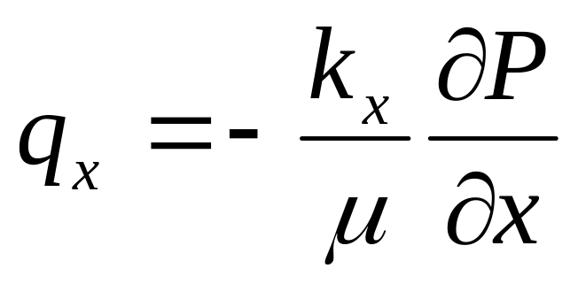
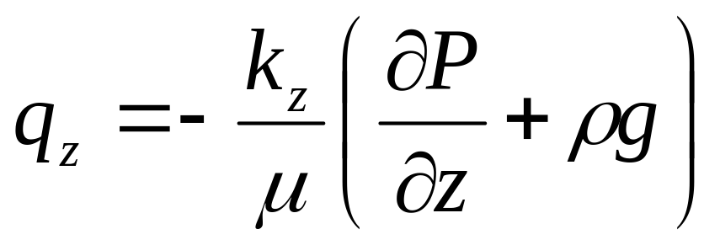
Darcy’s Law

Slide 12
Head-Based Formulation?
Many variable-density codes solve equations in terms of pressure, but equations can also be formulated using head
Why head instead of pressure?
  Perhaps more intuitive
  Use popular codes, such as MODFLOW?
Complication: what is “head” in a variable-density system?

Slide 13
Measures of Head
piezometer filled
with aquifer water
at well opening
piezometer filled
with freshwater
piezometer filled
with adjacent aquifer water
h_{f}
h
h_{e}
freshwater
brackish water
seawater
point-water
head (h)
freshwater
head (h_{f})
environmental
head (h_{e})

Slide 14


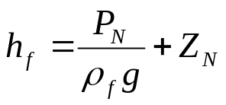
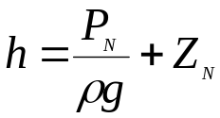

Point-Water and Freshwater Head
A
B
Piezometer filled
with freshwater
Piezometer filled
with saline water
h: head
h_{f}: equivalent freshwater head
P: pressure
ρ: density
ρ _{f} : density of freshwater
g: gravity
Z: elevation
N
Datum

Slide 15
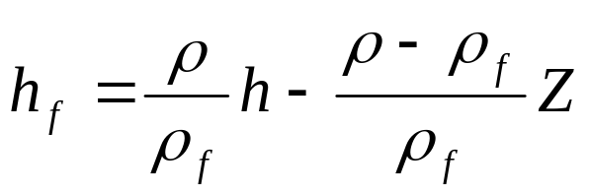

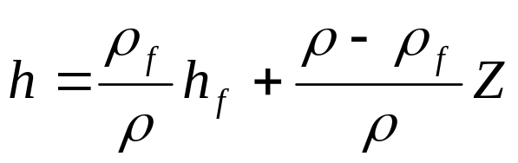
Converting between h_{f} and h

Slide 16
Lusczynski (1961)
Horizontal flow is proportional to the gradient of freshwater head
Vertical flow is proportional to the gradient in environmental head
Horizontal and vertical flow are not necessarily proportional to the gradient of point-water head

Slide 17
Why use h_{f} in SEAWAT?
Conceptually straightforward (i.e. for freshwater system, h_{f} = h)
Finite-difference form of governing equation can be solved by MODFLOW (with a few modifications)

Slide 18
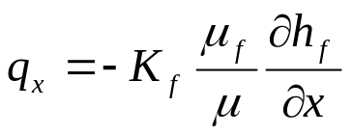

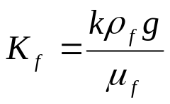
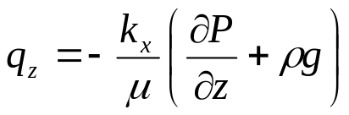
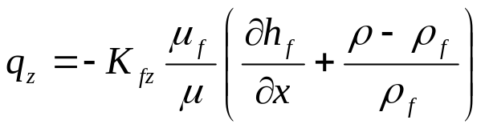
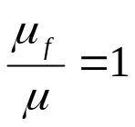
Darcy’s Law
equivalent freshwater head and hydraulic conductivity
pressure and permeability
can assume

Slide 19

Be Careful! Some Published Material is Incorrect
“If the density of water in aquifers varies vertically, all point-water heads should be converted to fresh-water pressure heads. Fresh-water heads can then be determined and used for the determination of hydraulic gradients and flow directions.”
“For theoretical reasons equivalent fresh-water heads cannot be used to determine the hydraulic gradient in aquifers where there is a lateral variation in density.”

Slide 20




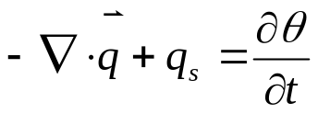
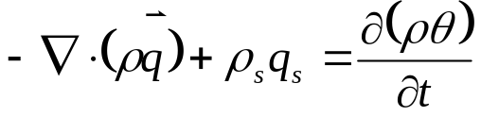
Governing Equation for Flow
constant density
variable density
Δx
Δx

Slide 21
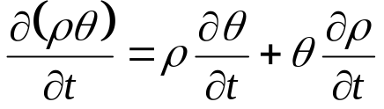


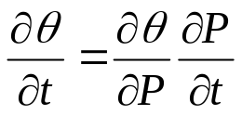
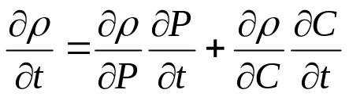
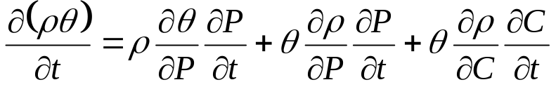
Storage Term

Slide 22
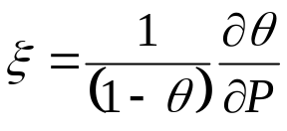
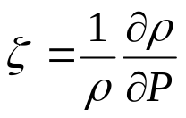
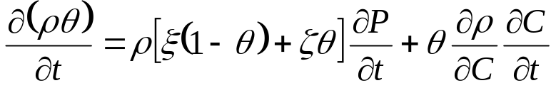
Storage Term (cont.)
compressibility of
the aquifer
compressibility
of water
accumulation of mass
as a result of concentration
changes
Formulated in terms of pressure

Slide 23

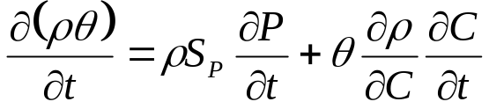


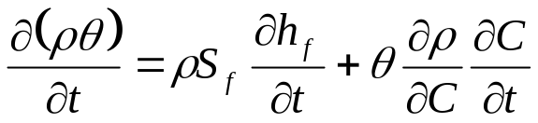
Storage Term (cont.)
Bear, 1979
Formulated in terms of h_{f}; Used in SEAWAT

Slide 24
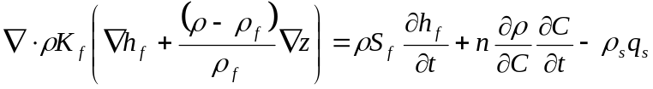
Governing Equation for Variable-Density Flow
or

Slide 25
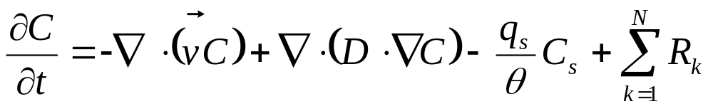
Governing Equation for Solute Transport
ADV
DSP
SSM
RCT

Slide 26
Equation of State
Equation of state is used to relate fluid density to pressure, temperature, and concentration
Most rigorous form:
  ρ = ρ ₀exp[B_{P}(P-P₀) + B_{T}(T-T₀)+Β_{C}(C-C₀)]
  Β_{P} = 1/ ρ*δρ/δP|_{T,C} (fluid compressibility)
  Β_{T} = 1/ ρ*δρ/δT|_{P,C} (fluid coefficient of thermal expansion)
  Β_{C} = 1/ ρ*δρ/δC|_{P,T} (slope of fluid density as a function of solute concentration, divided by reference density)
A linear approximation is often used, which can be written as:
  ρ = ρ ₀[1 + B_{P}(P-P₀) + B_{T}(T-T₀)+Β_{C}(C-C₀)], or
  ρ = ρ ₀+ dρ/dP* (P-P₀) + dρ/dT* (T-T₀) + dρ/dC* (C-C₀)]
In SEAWAT, we assume that density is not affected by pressure or temperature, and that the reference density is freshwater with a concentration of zero
  ρ = ρ _{f} + dρ/dC * C
  DENSE = DENSEREF + DENSESLP * CONC
Value for dρ/dC is about 0.7143 (25/35) for a freshwater-seawater mixture, if density and concentration are expressed in equivalent units
Note: parts of this taken from Kipp (1987), Kolditz et al. (1998) and Diersch and Kolditz (2002)

Slide 27
Coupled Flow and Transport
Groundwater flow is affected by fluid density
  q = f(ρ,…)
Concentration is affected by flow velocity (advection and dispersion)
  C = f(q,…)
Fluid density is function of solute concentration
  ρ = f(C)

Slide 28
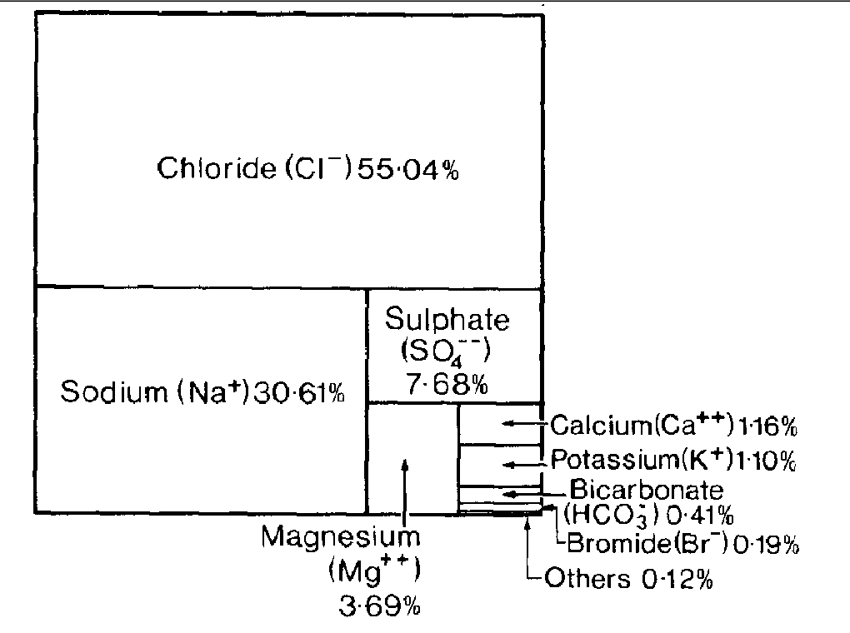
Major Constituents in Seawater

